Slide 1
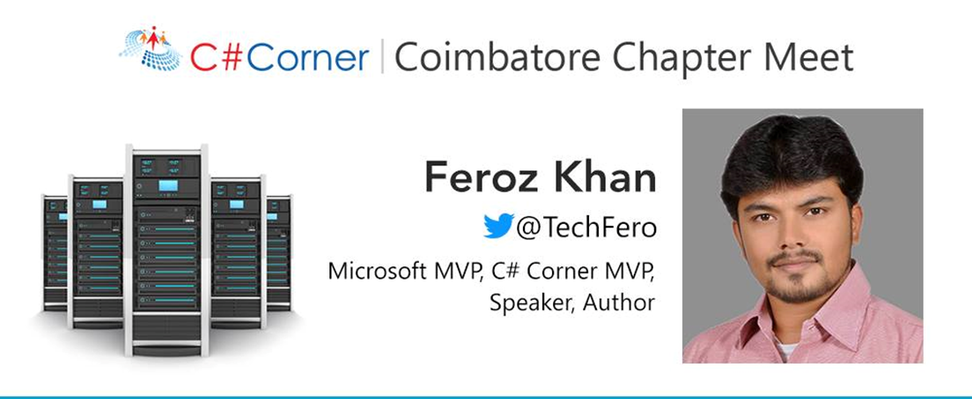
Traffic Manager on Azure
#CSharpCorner | #azuremvp @TechFero | @CodeSizzler

Slide 2
Agenda:
About Managing your Traffic on Azure
Priority based | Performance based | Geographic based | Weight based
Hands on with Priority based routing
#CSharpCorner | #azuremvp @TechFero | @CodeSizzler

Slide 3
Why Traffic Manager on Azure?
Manage traffic on your applications – may be Windows or Linux machines
#CSharpCorner | #azuremvp @TechFero | @CodeSizzler

Slide 4
Priority based routing
Set priorities for the servers which are connected
#CSharpCorner | #azuremvp @TechFero | @CodeSizzler

Slide 5
Weight based routing
Based on round robin scheduling algorithm
#CSharpCorner | #azuremvp @TechFero | @CodeSizzler

Slide 6
Performance based routing
Based on lesser time interval
#CSharpCorner | #azuremvp @TechFero | @CodeSizzler

Slide 7
Geographic based routing
Based on the nearest geographic location of incoming traffic
#CSharpCorner | #azuremvp @TechFero | @CodeSizzler

Slide 8
Links for handouts –
http://bit.do/tmcodesizzler
#CSharpCorner | #azuremvp @TechFero | @CodeSizzler

Slide 9
Hands on – Traffic Manager on Azure using priority based routing
#CSharpCorner | #azuremvp @TechFero | @CodeSizzler

Slide 10

Thanks for joining us!!
Abdul Rasheed Feroz Khan
Feel free to reach me for any queries:
@TechFero | @CodeSizzler
developer.fero@outlook.com
#CSharpCorner | #azuremvp @TechFero | @CodeSizzler

